Slide 1
House Prices
DRIVING FACTORS
By Alexandra Wells

Slide 2
INTRODUCTION
Business Objective
As Investors lend money to home buyers in mortgage-backed securities, success is dependent on the bank’s ability to identify good investments.
By identifying different qualities and home features that impact home prices, we are able to make better investment decisions.
As an analyst, our objective is to analyze the statistical relationships of home factors and home prices and identify the driving factors.

Slide 3
OVERVIEW
EXTERNAL FACTORS
External factors like supply and demand and economic growth have an affect on home prices.
FACTORS TO CONSIDER
Qualities of the home and property have a big impact on prices.
METHOD
Find statistical relationships and correlations between numerical variables and sale price.

Slide 4
ABOUT THE DATA
$755,000
Maximum Sales Price
2006-2010
Years houses were sold between
$180,921.20
1460
Average Sales Price of house in Ames, Iowa
Total number of houses in data collection
$34,900
Minimum Sales Price
Notes:
For this analysis, the data set was a sample of 1460 houses in Ames, Iowa that were sold between 2006-2010.
This data originally comes from Kaggle: https://www.kaggle.com/alphaepsilon/housing-prices-dataset

Slide 5
TOP FACTORS THAT DRIVE HOME PRICES
#1
#2
OVERALL QUALITY
#3
YEAR REMODEL ADDED
#4
NEIGHBORHOOD
GARAGE TYPE
Notes:
This project was done in Excel by utilizing pivot tables and the Data Analysis ToolPak to manipulate the data.
T-tests:
Picked out a handful of categorical variables based on research and conducted T-tests to test the significance of their effects on home prices.

Slide 6
OVERALL QUALITY VS. OVERALL CONDITION
QUALITY
AVERAGE SALES PRICE
CONDITION
Source: AW Housing Price Data (Quality vs. Condition)
Although Overall Quality is the top factor for predicting sale price, the same is not true for the Overall Condition of houses.

Slide 7
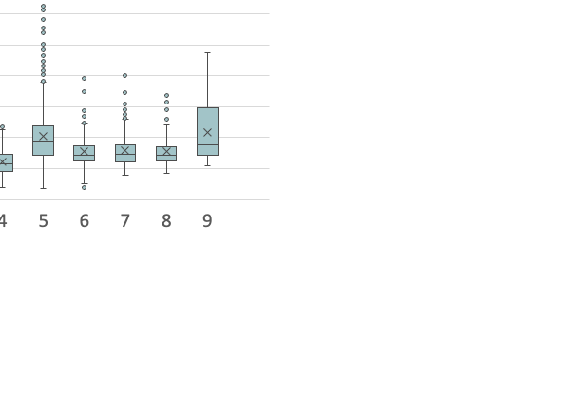
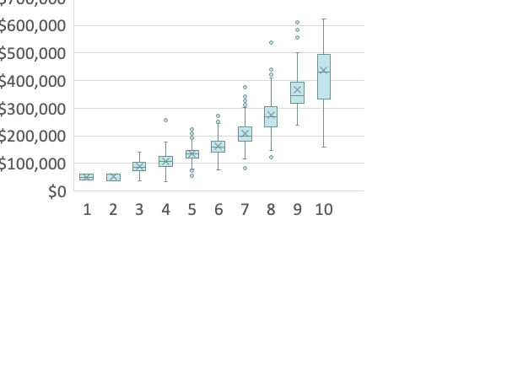
OVERALL QUALITY VS. OVERALL CONDITION
QUALITY
CONDITION
10
Source: AW Housing Price Data (Quality vs. Condition)
Notes:
Box plot

Slide 8
FOCUS
YEAR REMODEL ADDED 2001-2010
OVERALL CONDITION (1-10)
TOTAL LOT SIZE (BY SQUARE FEET) <10,000 vs. >10,000

Slide 9
OVERALL CONDITION
1-5 Rating in Overall Condition
6-10 Rating in Overall Condition
$194,684
-18.73%
$158,216
Source: AW Housing Price Data (Condition)
Outcome:
Though houses with a 6-10 rating in Overall Condition are in better state, the higher rating does not drive home prices as they have an 18.73% (-$36,468) less average sales price than houses with a 1-5 rating in overall condition.
Notes:
158216.2813

Slide 10
YEAR REMODEL ADDED
2001-2005
$269,007
2006-2010
33.66%
$201,263
Source: AW Housing Price Data (Year Remodel Added)
Outcome:
Houses with remodels added in the data set’s most recent 5 years (2006-2010) drive home prices 33.66% ($67,744) more than houses with remodels added before 2006.

Slide 11
TOTAL LOT SIZE (IN SQFT)
<10,000 sqft.
$217,049
>10,000 sqft.
40.91%
$154,030
Source: AW Housing Price Data (Lot Area)
Outcome:
Houses with a total lot area greater than 10,000 square feet drive home prices 40.91% ($63,019) more than houses with a total lot area less than 10,000 square feet.

Slide 12
CONCULSION
CONDITION
Though overall quality is significant factor in what drives home prices, condition does not have the same correlation and is not identified as a important factor in investment decisions.
RECENT REMODELING
The more recently the remodel was added to the house drives home prices as the the average home price of houses with remodels added between 2006-2010 are 43.77% more expensive than the average home price of houses with remodels built prior (1950-2005).
LOT SIZE
The size of the lot greatly affects house price as more land increases the price as houses with over 10,000 square footage are 40.91% more expensive than houses with under 10,000 square footage.
GOOD
LOCATION
Different neighborhoods drive home prices substantially with home prices in the most expensive neighborhood on average are 240.14% more expensive than the average home price in the least expensive neighborhood and 96.38% more expensive than the over-all average home price.
RECOMENDATION
We recommend that the Company executes its investments by allocating mortgage-backed securities to houses with
a combination of the identified top driving factors of home price: Overall Quality, Recent Remodeling, Neighborhood, and Garage Type.

Slide 13
THANKS
Does anyone have any questions?
Alexandra.browne.wells@gmail.com
linkedin.com/alexandrawells2019

